Slide 1
JS Event Loop
JS for Dinosaur

Slide 2
What is JAVA SCRIPT
JS Is A SINGLE-THREADED, NON-BLOCKING, ASYNCHRONOUS, CONCURRENT language
IN JS CALL STACK, an EVENT LOOP, a CALLBACK QUEUE, some OTHER APIs, and stuffs…

Slide 3
Overview of JS EVENT LOOP
Lets find out

Slide 4
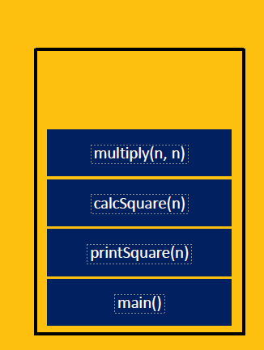
THE CALL STACK
One thread == One call stack == One thing at a time
function multiply(a, b){
return a * b;
}
function calcSquare(n){
return multiply(n, n);
}
function printSquare(n){
var result = calcSquare(n);
console.log(result);
}
printSquare(4);

Slide 5
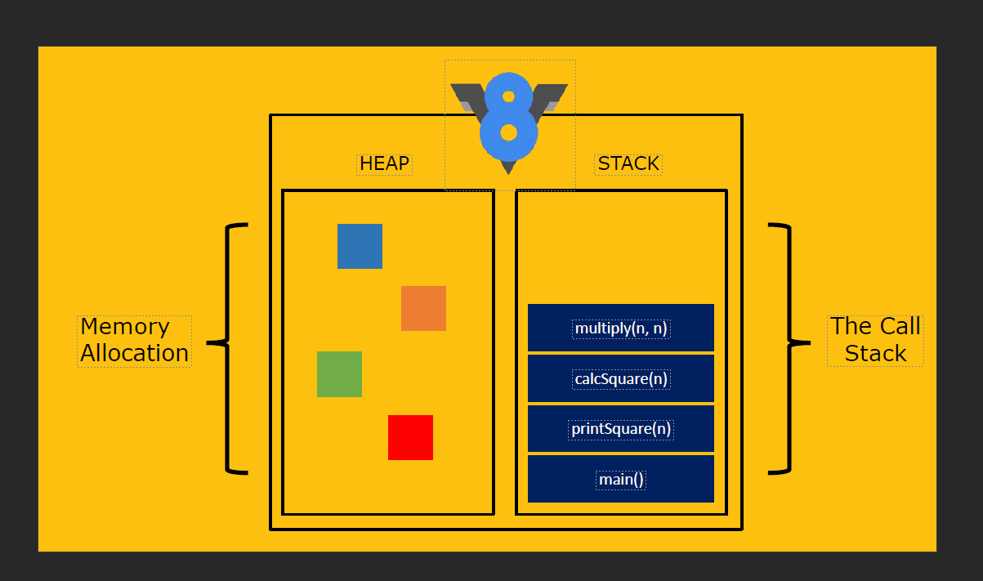
Notes:
Ref: https://www.slideshare.net/Designveloper-DSV/javascript-event-loop-64720816?from_action=save

Slide 6
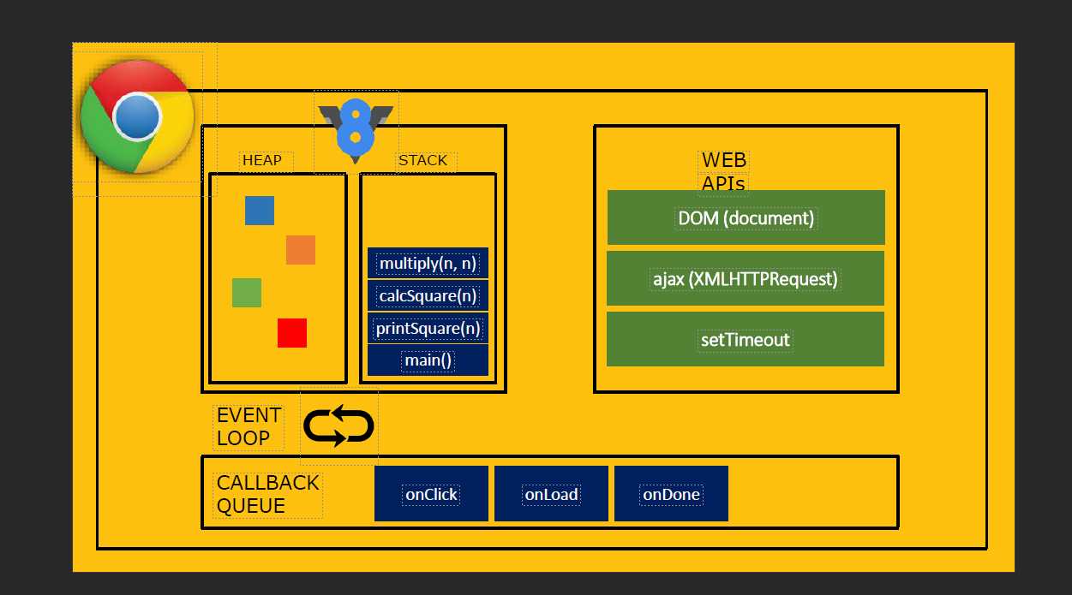

Slide 7
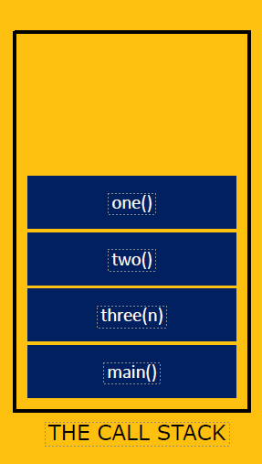
function one(){
throw new Error(“Oops!”);
}
function two(){
one();
}
function three(n){
two();
}
three();

Slide 8
THE CALL STACK
When Debugging
function stackTrace(){
var err = new Error();
return err.stack;
}

Slide 9
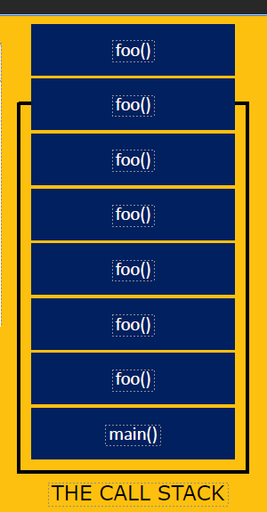
What will happen now
function foo(){
return foo();
}
foo();

Slide 10
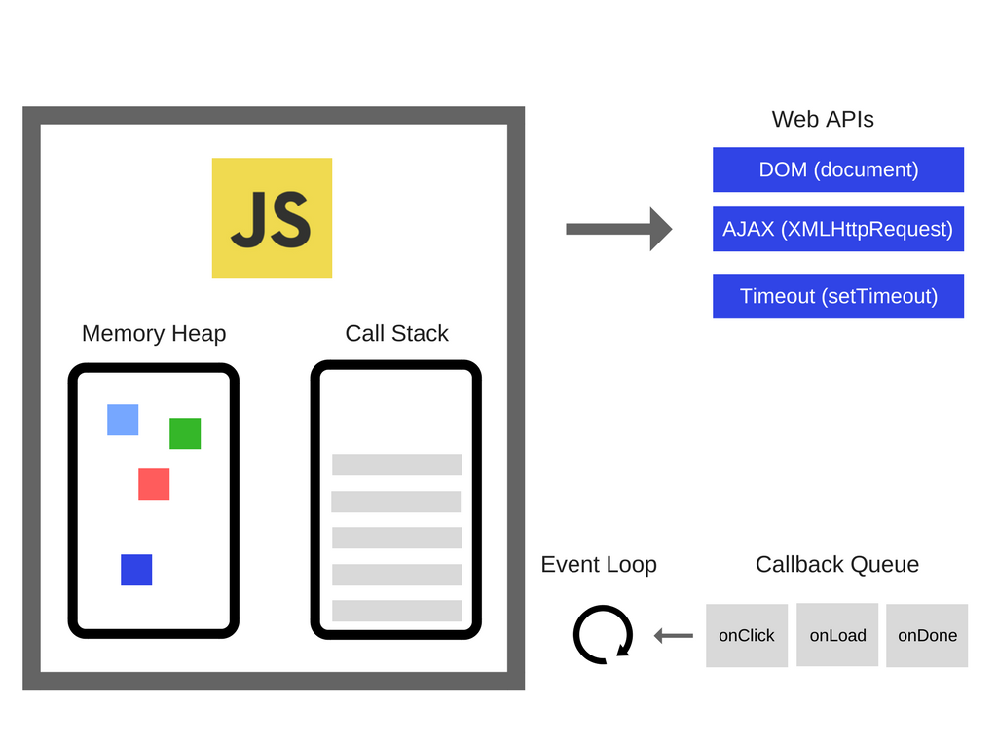
Notes:
Reference : https://blog.sessionstack.com/how-javascript-works-event-loop-and-the-rise-of-async-programming-5-ways-to-better-coding-with-2f077c4438b5

Slide 11
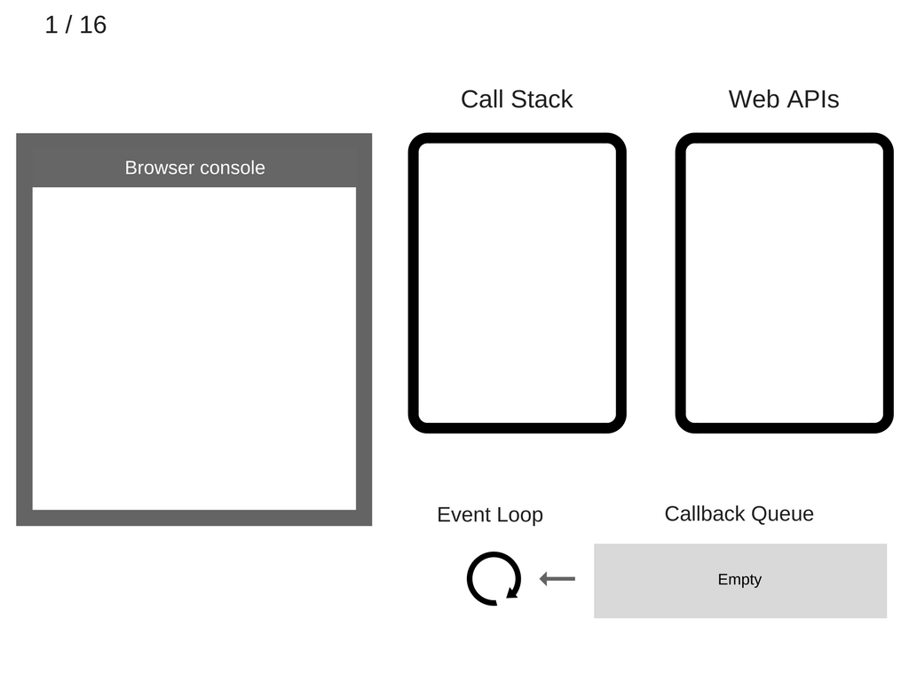
console.log('Hi’);
setTimeout(function cb1() {
console.log('cb1’);
}, 5000);
console.log('Bye');

Slide 12
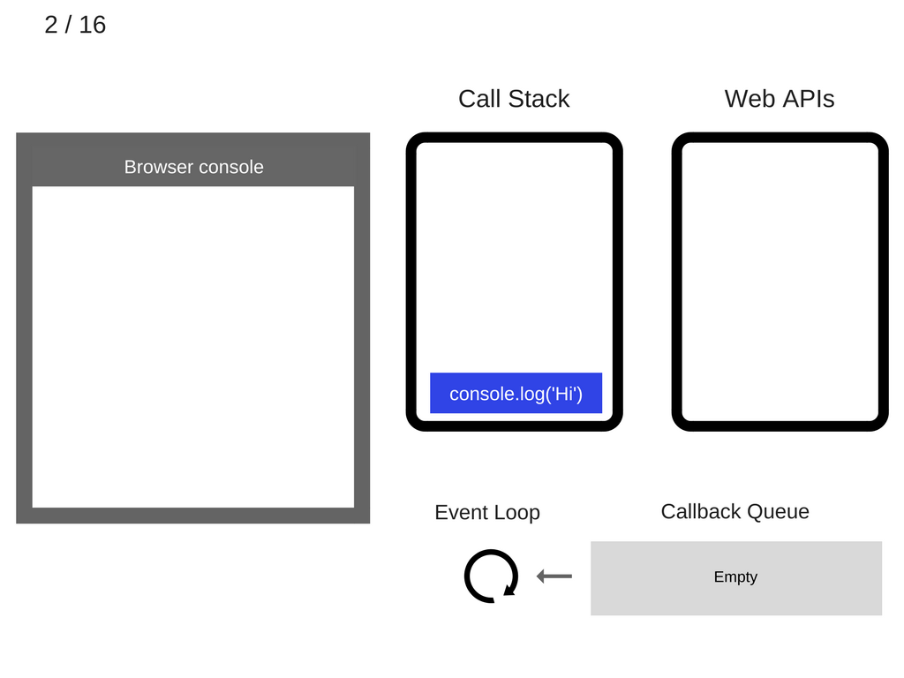

Slide 13
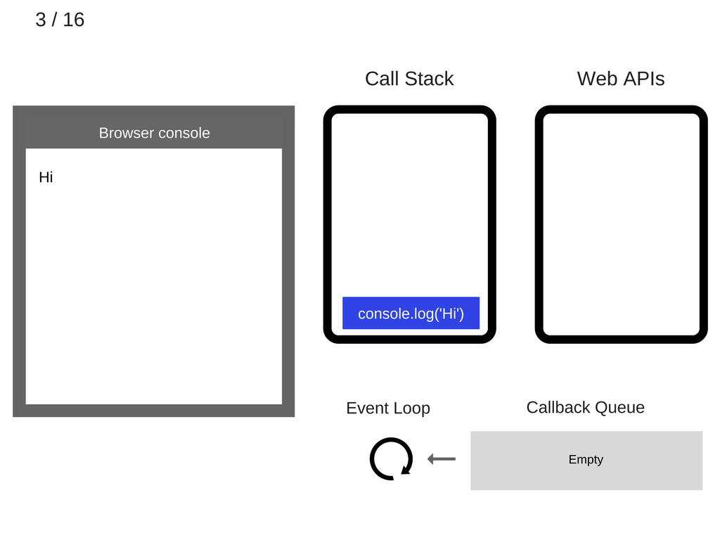

Slide 14
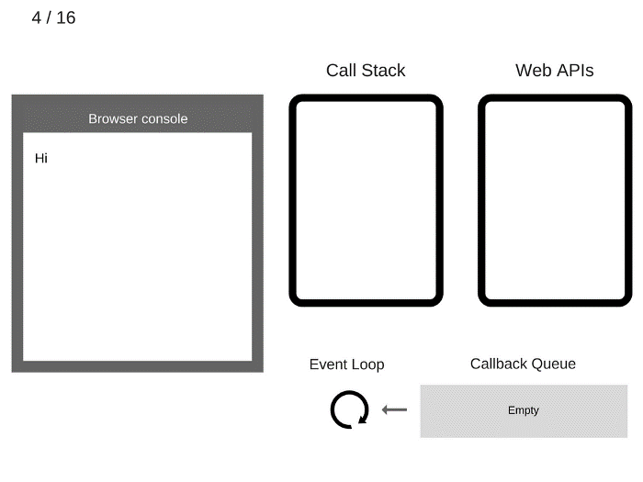

Slide 15


Slide 16
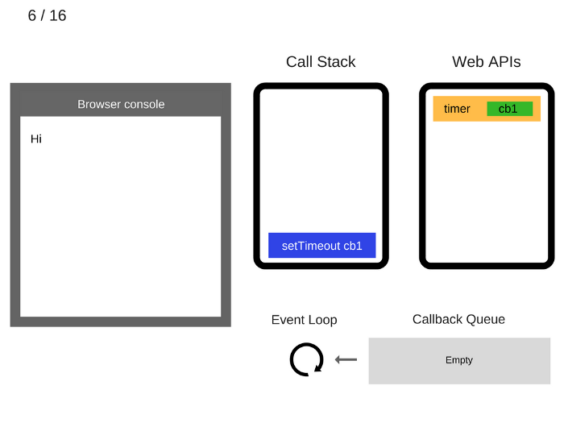

Slide 17
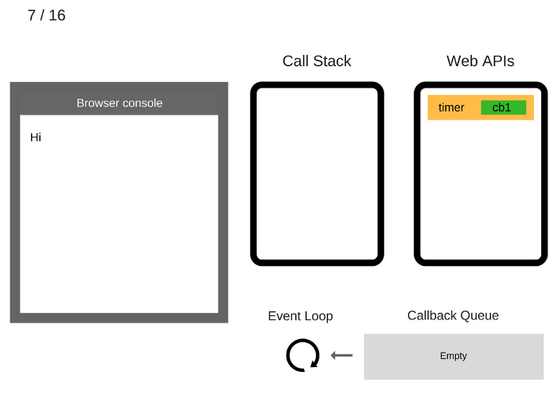

Slide 18
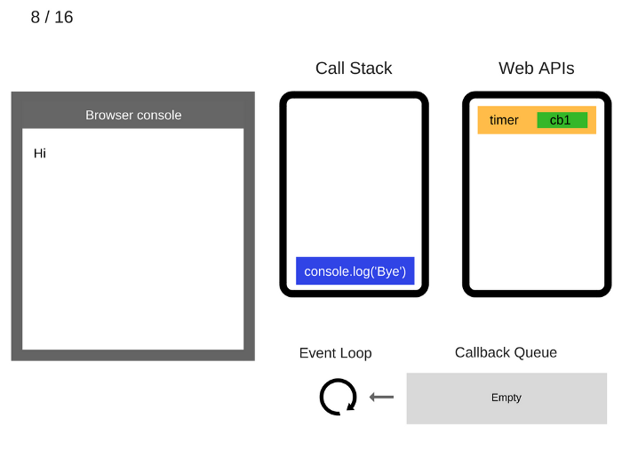

Slide 19


Slide 20


Slide 21
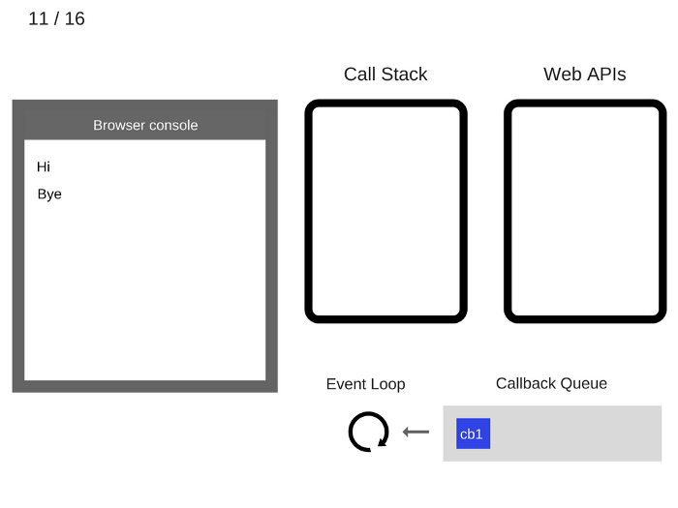

Slide 22


Slide 23
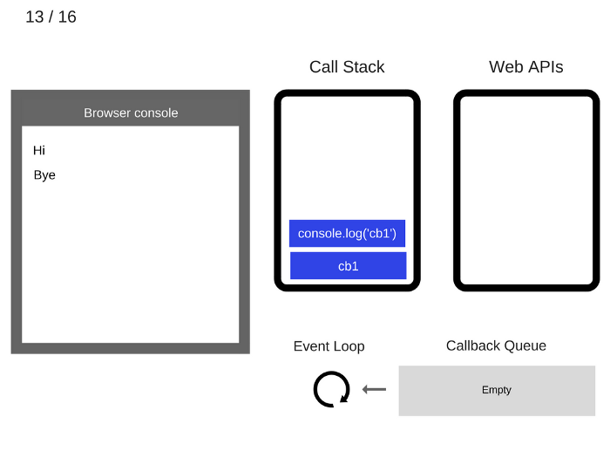

Slide 24


Slide 25


Slide 26
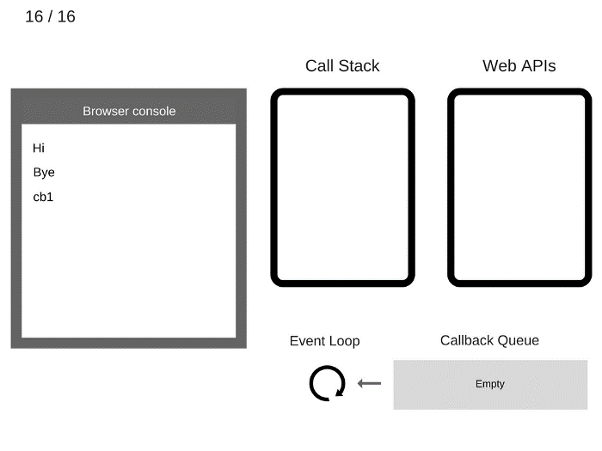

Slide 27
console.log('Hi’);
setTimeout(function() {
console.log('callback’);
}, 0);
console.log('Bye');
OUTPUT:
Hi
Bye
callback

Slide 28
$.on('button', 'click', function onClick() {
setTimeout(function timer() {
console.log('You clicked the button!');
}, 2000);
});
console.log("Hi!");
setTimeout(function timeout() {
console.log("Click the button!");
}, 5000);
console.log("Welcome to loupe.");
console.log("1");
setTimeout(function time() {
console.log("in timeout");
},0)

Slide 29
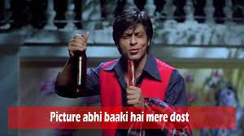

Slide 30
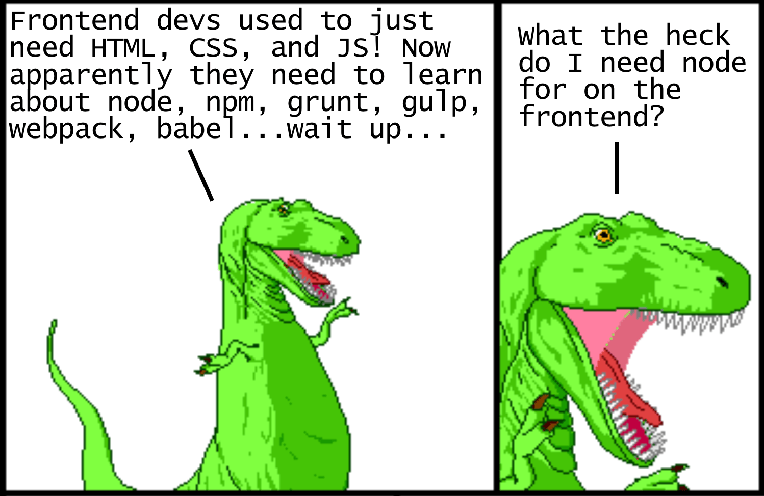
Notes:
Reference : https://miro.medium.com/max/2996/1*H8PH-HaV43gZyBJz0mJHxA.png

Slide 31
This is where a module bundler comes in

Slide 32
???
References:
https://blog.sessionstack.com/how-javascript-works-event-loop-and-the-rise-of-async-programming-5-ways-to-better-coding-with-2f077c4438b5
https://medium.com/the-node-js-collection/modern-javascript-explained-for-dinosaurs-f695e9747b70
http://howtonode.org/understanding-process-next-tick

